Slide 1



Artificial Intelligence for Patient Management
and Clinical Research in Rheumatology
Developed by:
Mr. Ismail Bakraoui
Under the supervision of :
Dr. Housbane Samy and Dr. Ajbal Khaoula
2 March 2025 - 3rd Meeting
EMSI - FMPC

Slide 2
Virtualization Infrastructure Strategy Using Proxmox VE
Application Server
Database Server
AI Engine
Backup & Monitoring
Security Considerations
2

Slide 3
Application Server
3

Slide 4
Application Server
This virtual machine hosts the hospital information system’s application layer. It manages user access, business logic, and communication between clinical users and backend services. Separating the application layer ensures operational flexibility and controlled maintenance.
Processes user authentication and application logic
Handles secure communication with the database and AI services
Allows independent updates without impacting other services
4

Slide 5
Database Server (MySQL)
5

Slide 6
Database Server
This virtual machine is dedicated to structured medical data storage, ensuring secure handling of patient records and clinical information. Isolation strengthens data protection and system integrity.
Stores patient records and clinical acts
Restricted access limited to the application server
Independent resource allocation for performance stability
6

Slide 7
AI ENGINE
7

Slide 8
AI Engine
This virtual machine supports clinical AI processing and advanced data retrieval mechanisms. Isolation ensures computational workloads do not affect core system performance.
Executes AI-based semantic retrieval and analysis
Operates independently from core database services
Scalable if AI demand increases
8

Slide 9
Backup & Monitoring
9

Slide 10
Backup & Monitoring
This virtual machine ensures operational continuity through automated backup and system supervision. It supports rapid restoration in case of failure.
Scheduled database and VM backups
Snapshot-based recovery capability
Continuous performance and health monitoring
10

Slide 11
Security Considerations
11

Slide 12
Security Considerations
The virtualization model incorporates layered security principles aligned with hospital governance standards. Service isolation reduces systemic risk and enhances data protection.
Network segmentation between virtual machines
Role-based access control at infrastructure level
Firewall and controlled internal communication
12

Slide 13
Infrastructure Summary – 4 Virtual Machines
The proposed virtualization strategy is structured around four dedicated virtual machines hosted on Proxmox VE. Each VM is assigned a specific operational role to ensure service isolation, stability, and controlled scalability within the hospital information system.
VM 1: Application Server
VM 2: Database Server
VM 3: AI Engine
VM 4: Backup & Monitoring
13

Slide 14
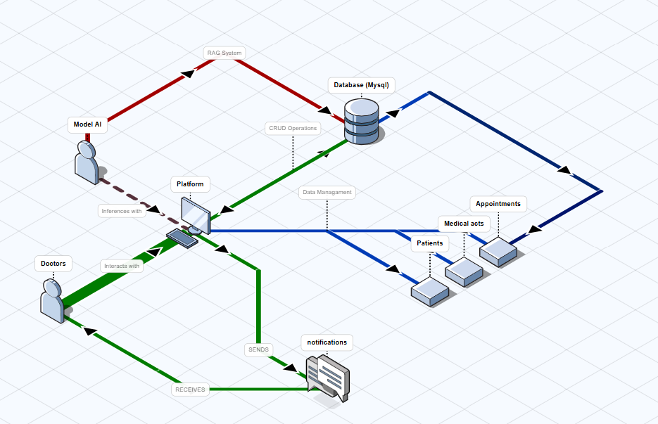
14

Slide 15
Added App Features
New UI For the model cards (appointments, acts and patients)
New calendar system with listing.
New dashboard with a recent activity log
Doctor Profile log in system
PDF extraction and downloading of medical acts
Redone the AI assistant UI and made the buttons work accordingly
Real voice extraction
15

Slide 16
Artificial Intelligence for Patient Management
and Clinical Research in Rheumatology
Developed by:
Mr. Ismail Bakraoui
Under the supervision of :
Dr. Housbane Samy and Dr. Ajbal Khaoula
2 March 2025 - 3rd Meeting
EMSI - FMPC

